Slide 1

UEEN 3113 / 3413
Server Configuration and management

Slide 2
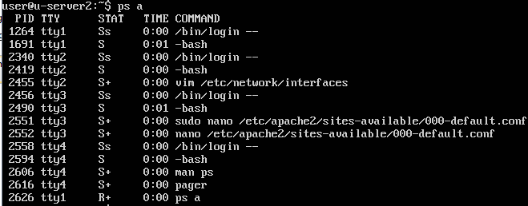
Process Monitoring
To view running processes, use ps command. E.g. ps a

Slide 3
Process Monitoring
Process status is indicated in the STAT column
D: uninterruptible sleep (waiting on input and cannot handle additional signals)
Z: defunct (zombie), finished its job but not terminated properly by its parent, if its parent exits, init() will destroy it
T: stopped by job control signal
S: interruptible sleep (waiting for event to complete)
R: in the run queue

Slide 4
Process Monitoring
Additional characters that might be displayed for process status
<: high-priority
N: low-priority
L: has pages lock into memory (for real-time / custom I/O)
s: is a session leader
l: is multi-threaded (using CLONE_THREAD)
+: in the foreground process group

Slide 5
Process Monitoring
The TIME column display the total amount of time the CPU has been utilised (amount of time the process has been actively engaging with the CPU).
Run ps au will list processes started by other users as well.
RSS means resident set size (non-swap physical memory that has been used)
VSZ means virtual memory size of the process
NI is the nice vale (19 to -20)

Slide 6
Process Monitoring
To list all processes including system processes:
ps aux
Processes in the […] bracket are processes that do not have an associated command line (kernel threads / system services / daemon).
PRI is the priority, higher number means lower priority.
START is the starting time of the process.
%CPU is CPU time used divide by the time the process has been running.

Slide 7
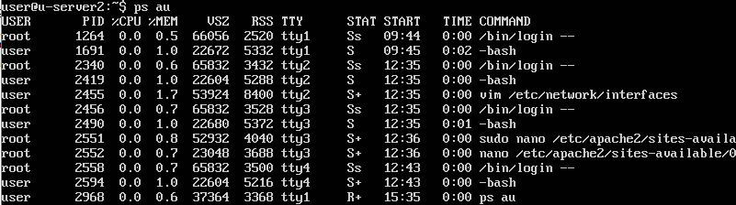
Process Monitoring
%MEM is the ratio of the process’s resident set size to the physical memory.

Slide 8
Process Monitoring
To view processes belong to specific user:
ps -u user_name
Use the --sort option to sort the output based on field specified
ps au --sort=field

Slide 9
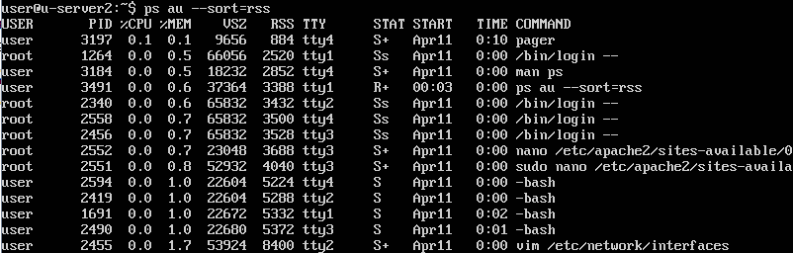
Process Monitoring

Slide 10
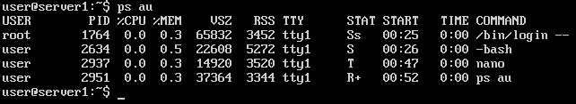
Process Monitoring
To send a process to background, press Ctrl+Z
Example, press Ctrl+Z while using nano will send it to background and return to the prompt

Slide 11

Process Monitoring
If there is only one background process, we can use the fg command to bring back the process
If there are a few background processes, fg will bring back the most recently working process.
To list all background processes, use the jobs command.
To bring a process, use the job ID in fg command, for example to bring back nano: fg 1

Slide 12

Process Monitoring
We can start a process in the background by executing the command with & at the end of command
For example: htop &
Caution!
When we exit the shell / logout, all background processes will close, unsaved work will be lost.

Slide 13
Process Monitoring
Ubuntu 16.04 uses systemd for init system. It uses systemctl command to manage services.
Ubuntu 14.04 and earlier use Upstart for init system. It uses service command to manage services. Examples:
service ssh status
service ssh stop

Slide 14
Process Monitoring
Some services are started by the scripts in /etc/init.d/, not by Upstart or systemd commands. Examples
/etc/init.d/ssh start
/etc/init.d/ssh stop
/etc/init.d/ssh status
/etc/init.d/ssh reload

Slide 15
Process Monitoring
To kill a process, use the kill command. By default, kill will send SIGTERM (value=15) signal to the process.
If SIGTERM unable to terminate a process, then we can forcibly terminate the process by sending the SIGKILL signal (value=9).
Examples
kill 2634 (this will send SIGTERM signal to process 2634)
kill -9 2644 (this will send SIGKILL signal to process 2644)

Slide 16
Process Monitoring
Other commonly used signals
SIGHUP (1) – hangup detected terminal, terminate process
SIGINT (2) – Interrupt from keyboard, terminate process
SIGALRM (14) – timer signal from alarm()

Slide 17
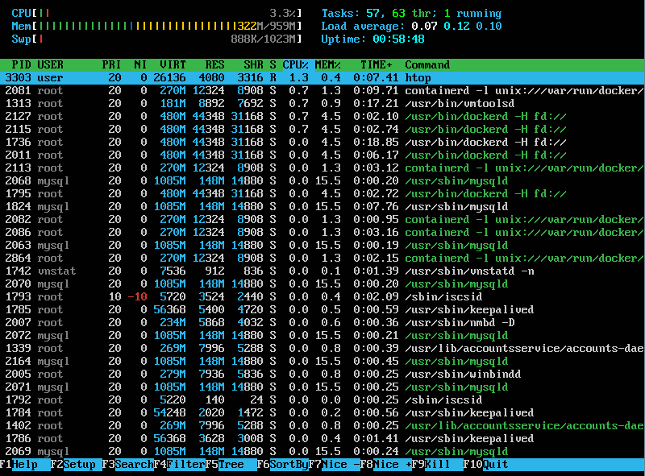
System Monitoring
There is a tool to monitor server performance, htop.

Slide 18

System Monitoring
The uptime command shows
how long the system has been running
the number of currently logged in users
load average for 1, 5 and 15 minutes intervals
The w command shows all currently logged in users

Slide 19
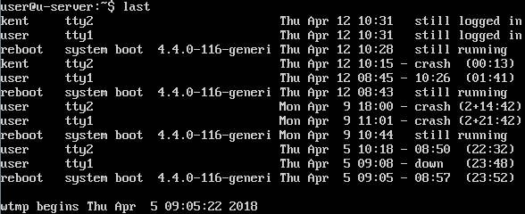
System Monitoring
The last command shows last logged in users

Slide 20
Network Monitoring
netstat - display the status of all network connections on a host. Examples
list all ports that are listening and connected, for TCP and UDP: netstat -natu
list only TCP connections: netstat -at
list only UDP connections: netstat -au
display IPv6 routing table: netstat -rn -A inet6

Slide 21
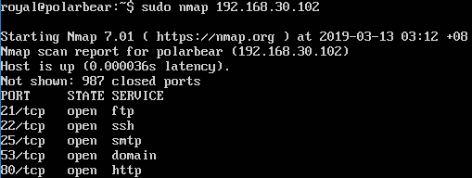
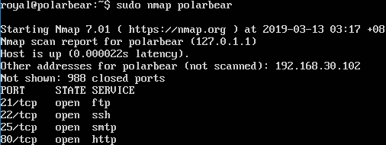
Network Monitoring
nmap – explore network, scan port
nmap IP
nmap domain

Slide 22
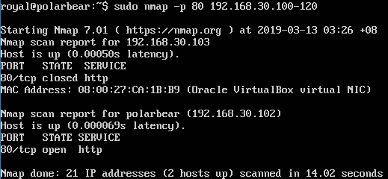
Network Monitoring
nmap – explore network, scan port
nmap –p port_number IP_range

Slide 23
Network Monitoring
Network sniffer captures packets for analysis
Default sniffer installed in Ubuntu server is tcpdump
Capture on specific interface: tcpdump -i eth0
List available interfaces on the system: tcpdump -D
Capture packets based on TCP port: tcpdump -i eth0 tcp
Capture Packet from Specific Port: tcpdump -i eth0 port 22
Capture Packets from source IP: tcpdump -i eth0 src 192.168.30.5
Capture Packets from destination IP: tcpdump -i eth0 dst 192.168.30.5

Slide 24
Network Monitoring
Other useful tools (require installation)
iftop - measures the data flow on individual socket connections
iptraf - interactive and colorful IP Lan monitor
vnstat - runs a background service/daemon and keeps recording the size of data transfer all the time
pktstat - displays all active connections in real time, and the speed at which data is being transferred

Slide 25


